Slide 1
Git and Github

Slide 2
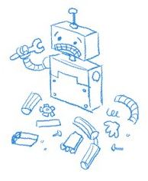

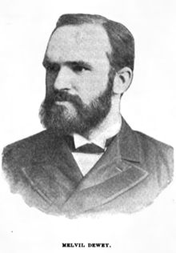
Why Git?
SharedDocuments
Documents
SharedDocuments
Rights.txt
Rights.txt
Article 1.
All human beings are born free and equal in dignity and rights. They are endowed with reason and conscience and should act towards one another in a spirit of brotherhood.
Article 1.
All Robot beings are made free and equal in dignity and rights. They are endowed with determinism and determinism and should act towards one another in a spirit of robothood.
???
???
???
Documents
Rights.txt
Article 1.
All ??????? beings are ??????? free and equal in dignity and rights. They are endowed with ??????? and ??????? and should act towards one another in a spirit of ???????.
0.0
0.1
Rights.txt

Slide 3



What’s Git (and Github)?

Slide 4

How Github works:
Documents
Git’s magic log file
BAT.csv
ImportantScript.Rmd
Github
git push Documents
git clone Documents
My computer
Your computer
Documents
Git’s magic log file
Documents
Git’s magic log file
BAT.csv
BAT.csv
ImportantScript.Rmd
ImportantScript.Rmd
SuperImportantScript.Rmd

Slide 5
How Github works:
Documents
Git’s magic log file
BAT.csv
ImportantScript.Rmd
SuperImportantScript.Rmd
Github
git pull Documents
git push Documents
My computer
Your computer
Documents
Git’s magic log file
Documents
Git’s magic log file
BAT.csv
BAT.csv
ImportantScript.Rmd
ImportantScript.Rmd
SuperImportantScript.Rmd
SuperImportantScript.Rmd

Slide 6
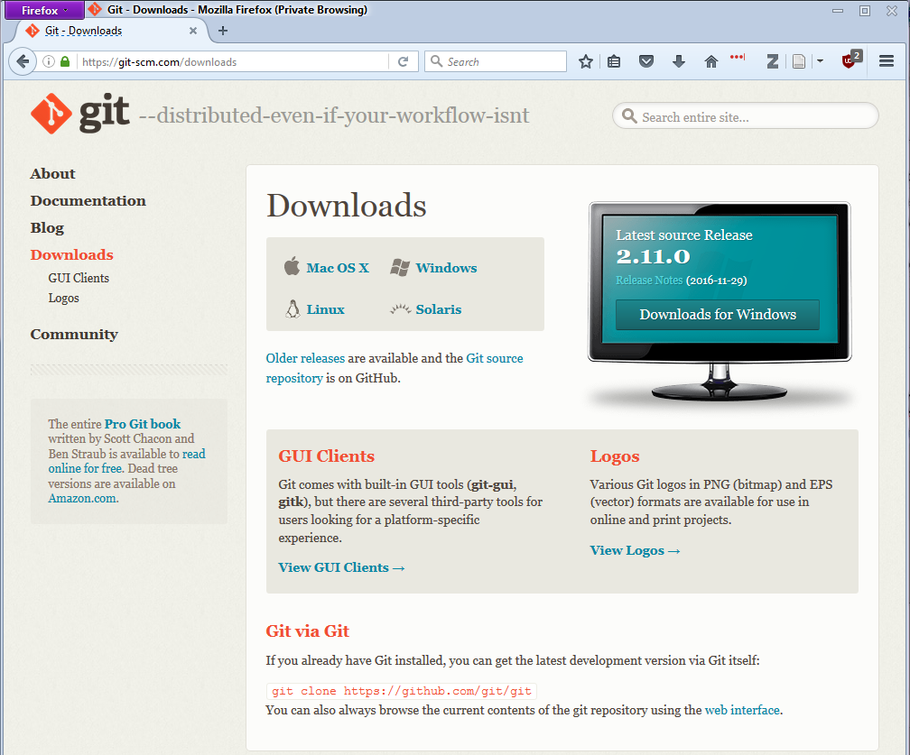
Get Git
https://git-scm.com/downloads

Slide 7
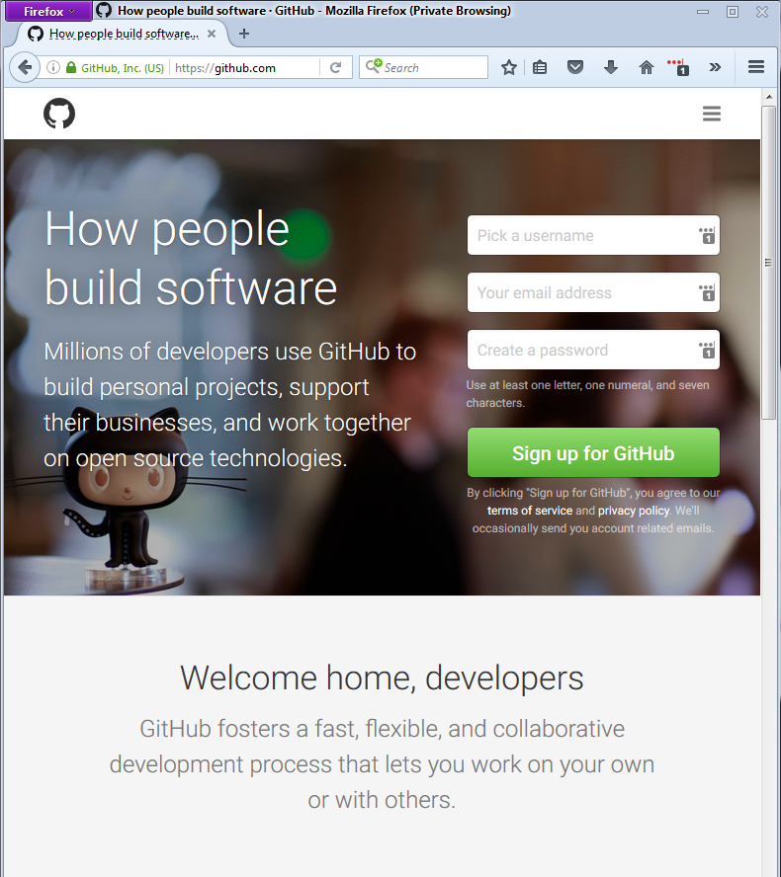
Get github
https://github.com

Slide 8
Git Demo

Slide 9
Git Demo Commands
Importing files
git clone https://github.com/218Lefevre/R_Club
Adding files to tracking
git add FileName
git commit –m FileName
git push
Retrieving other’s tracked files
git status
git pull

Slide 10
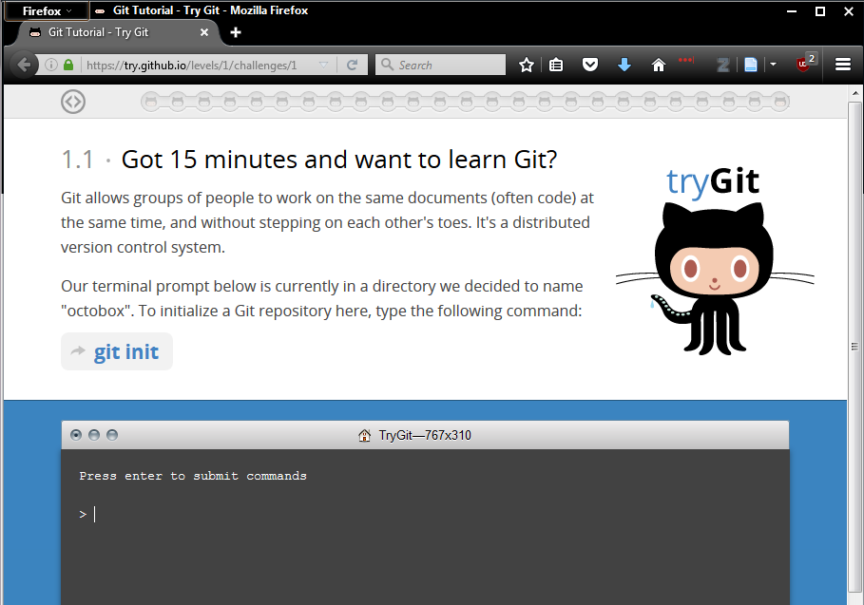
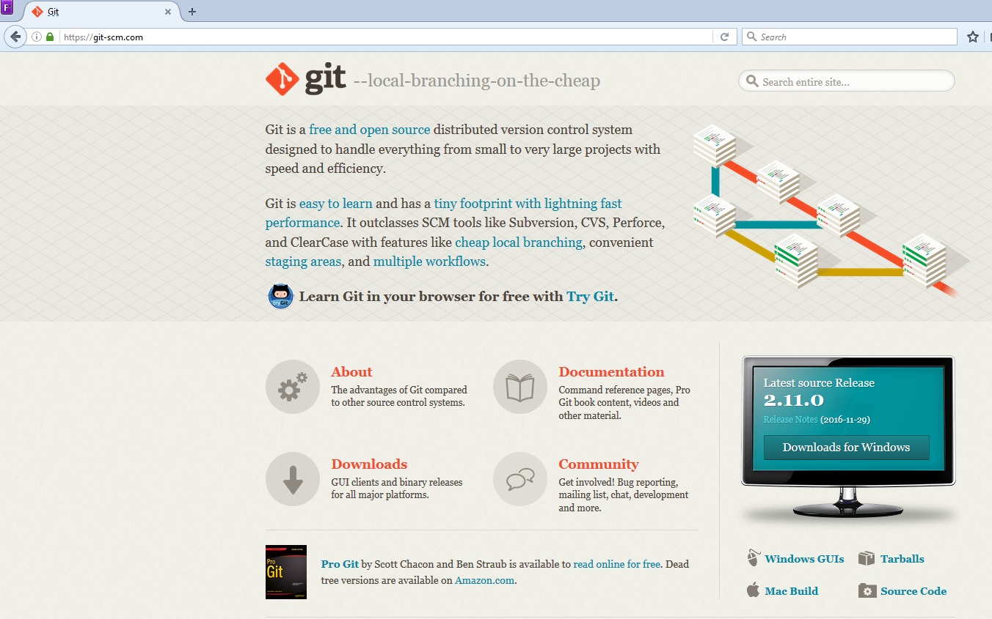
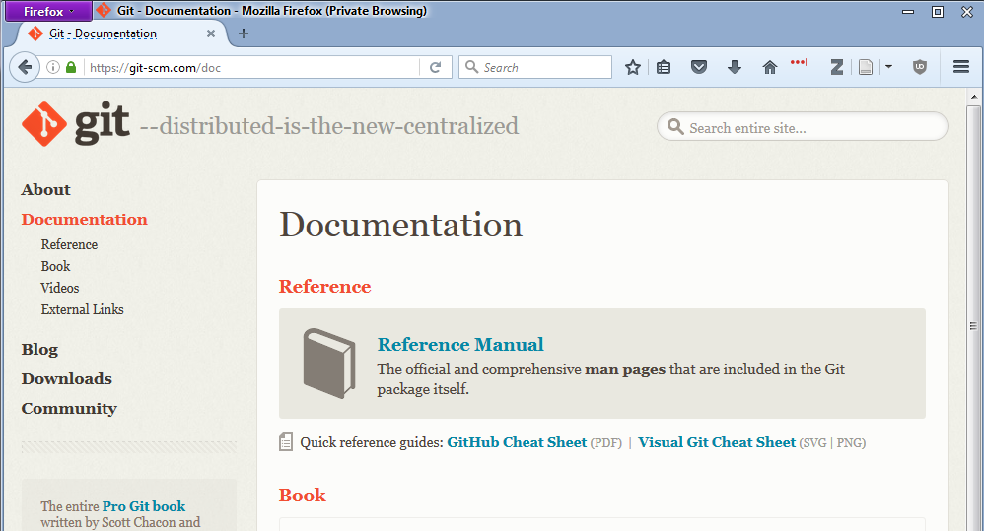
Additional Resources:
https://try.github.io/levels/1/challenges/1
https://git-scm.com/
https://git-scm.com/doc

Slide 11
